Slide 1



Covid-19 Face Mask Detection Using
TensorFlow, Keras and OpenCV
Roll No:1911101
Name:Kush Patel

Slide 2
Contents:
Introduction
Challenges Faced
Dataset
Incorporated Packages
The proposed Method
Result And Analysis
Implementation Strategy
Conclusion

Slide 3
Introduction
To curb certain respiratory viral ailments, including COVID-19, wearing a clinical mask is very necessary. The public should be aware of whether to put on the mask for source control or aversion of COVID-19. Therefore, face mask detection has become a crucial task in present global society. Face mask detection involves in detecting the location of the face and then determining whether it has a mask on it or not. This paper presents a simplified approach to serve the above purpose using the basic Machine Learning (ML) packages such as TensorFlow, Keras, OpenCV and Scikit-Learn.

Slide 4
Challenges Faced
Face detection is a difficult task because the faces change in size, shape, color, etc and they are not immutable. Authors of this paper think face detection comes with two major challenges:
1) unavailability of sizably voluminous datasets containing both masked and unmasked faces.
2) exclusion of facial expression in the covered area.

Slide 5
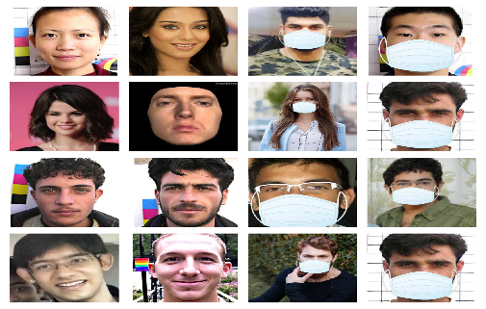
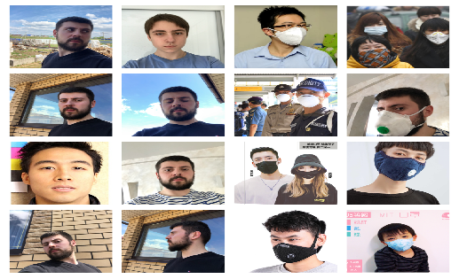
Dataset
Two datasets have been used for experimenting the current method. Dataset 1 consists of 1376 images in which 690 images with people wearing face masks and the rest 686 images with people who do not wear face masks.​
Dataset 2 from Kaggle consists of 853 images and its countenances are clarified either with a mask or without a mask.
figure 1
figure 2

Slide 6
Packages
A. TensorFlow
B. Keras
C. OpenCV

Slide 7
The Proposed Method
A) Data Processing
Data Visualization
Conversion of RGB image to Gray image
Image Reshaping
B) Training of Model

Slide 8
Data Processing
Data Visualization
Data visualization is the process of transforming abstract data to meaningful representations using knowledge communication and insight discovery through encodings. It is helpful to study a particular pattern in the dataset.

Slide 9
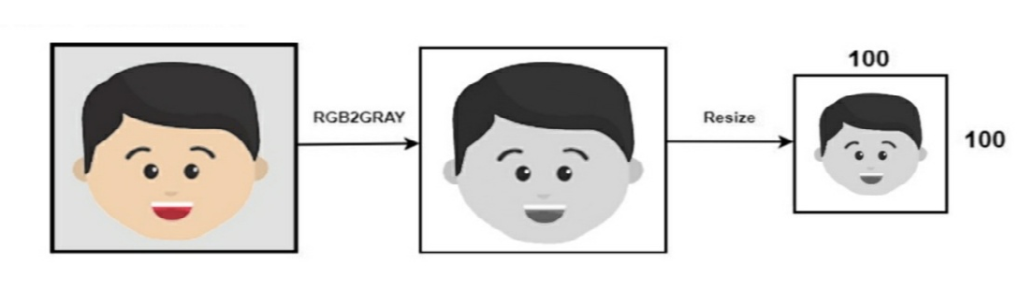
Data Processing
Conversion of RGB to Gray Image
Modern descriptor-based image recognition systems regularly work on grayscale images, without elaborating the method used to convert from color-to-grayscale. This is because the color-to-grayscale method is of little consequence when using robust descriptors

Slide 10
Data Processing
Image Reshaping
The input during relegation of an image is a three-dimensional tensor, where each channel has a prominent unique pixel. Most CNNs can only accept fine-tuned images, This stirs-up several problems through out data collection and implementation of model.The images are normalized to converge the pixel range between 0 and 1. Then they are converted to 4-d arrays.

Slide 11
Training Of Model
CNN has become ascendant in miscellaneous computer vision tasks . The current method makes use of Sequential CNN.The First Convolution layer is followed by Rectified Linear Unit (ReLU) and MaxPooling layers. The Convolution layer learns from 200 filters. As the model should be aware of the shape of the input expected, the first layer in the model needs to be provided with information about input shape. The activation parameter to the Conv2D class is set as “relu”. It represents an approximately linear function that possesses all the assets of linear models that can easily be optimized with gradient-descent methods.

Slide 12
RESULT AND ANALYSIS

Slide 13
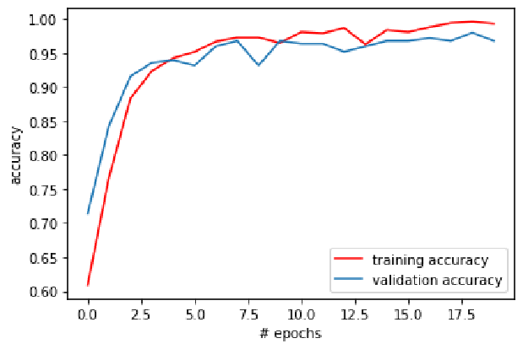
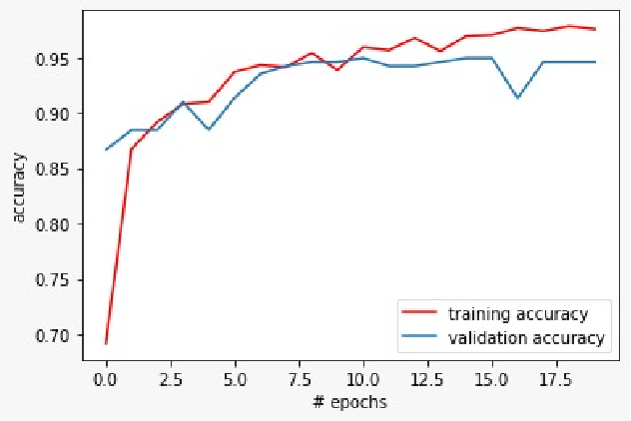
Figure 1
Figure 2

Slide 14
Conclusion
In this paper briefly explained the motivation of the work is briefly explained . then the learning and performance task of the model Using basic ML tools and simplified techniques the method has achieved reasonably high accuracy is illustrated. It can be used for a variety of applications. The deployed model will contribute immensely to the public health care system. It can be extended to detect if a person is wearing the mask properly or not. The model can be further improved to detect if the mask is virus prone or not i.e. the type of the mask is surgical, N95 or not.

Slide 15
References
[1] W.H.O., “Coronavirus disease 2019 (covid-19): situation report, 205”.
2020
[2] “Coronavirus Disease 2019 (COVID-19) – Symptoms”,
Centers for Disease Control and Prevention, 2020. [Online].
Available: https://www.cdc.gov/coronavirus/2019-ncov/symptoms_x0002_testing/symptoms.html. 2020.
[3] “Coronavirus — Human Coronavirus Types — CDC”, Cdc.gov, 2020.
[Online]. Available: https://www.cdc.gov/coronavirus/types.html. 2020.
[4] W.H.O., “Advice on the use of masks in the context of COVID-19:
interim guidance”, 2020.
[5] M. Jiang, X. Fan and H. Yan, “RetinaMask: A Face Mask detector”,
arXiv.org, 2020. [Online]. Available: https://arxiv.org/abs/2005.03950.
2020.

Slide 16
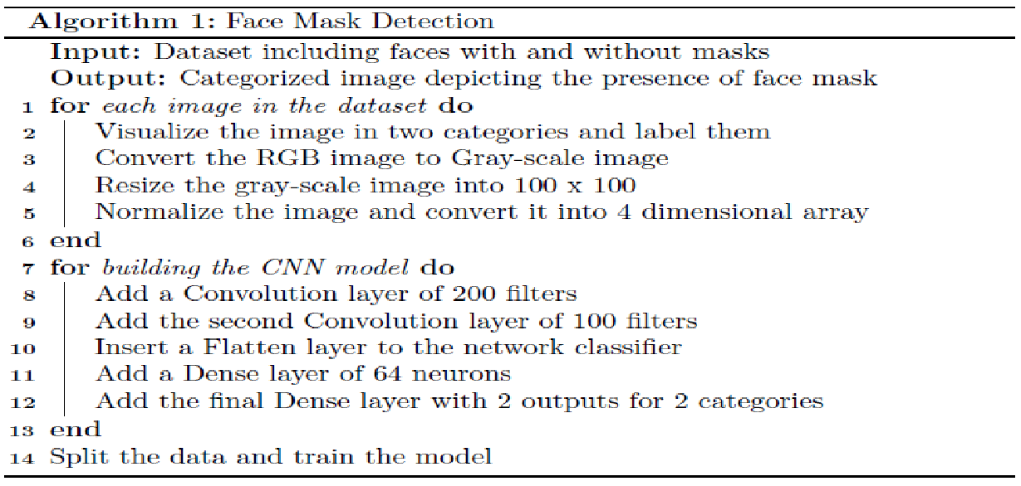
Implementation

Slide 17
Thank You

